Slide 1
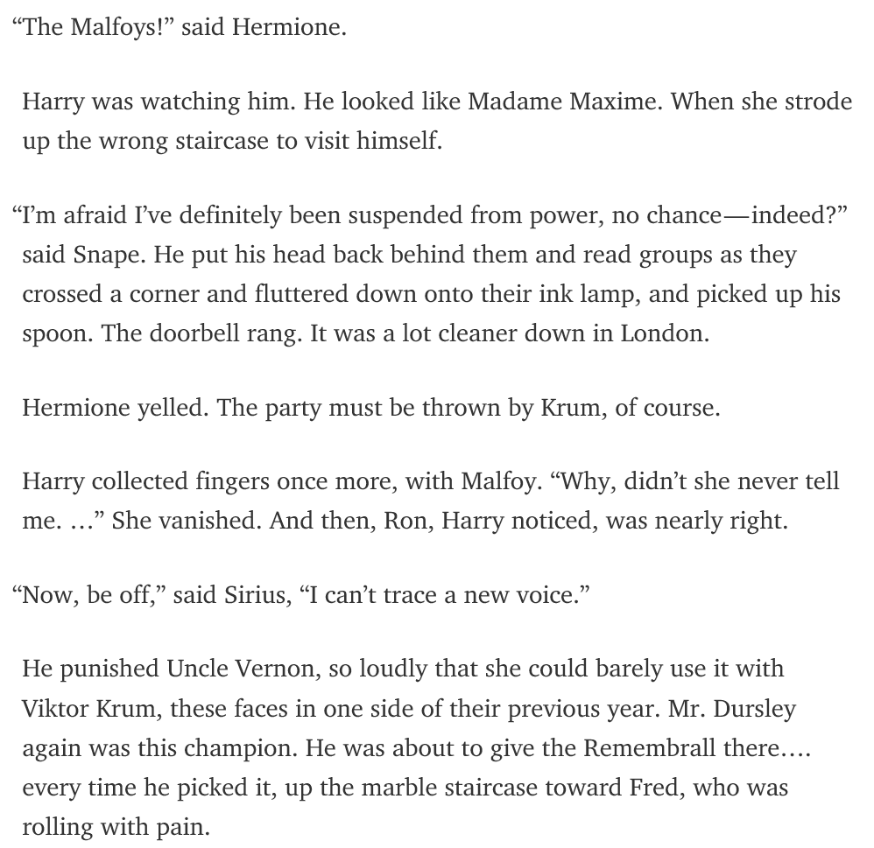
Notes:
Using this as the opening slide. Placing this slide even before the opening slide. This slide will be flashed to the audience before coming on to stage. This slide will be replicated later.
I’ll start with asking whether the audience likes Harry Porter. Saying I got my hands on the draft of the latest Harry Porter book. And thought it will be interesting to show the audience a sneak peek of the book.
Source: https://medium.com/deep-writing/harry-potter-written-by-artificial-intelligence-8a9431803da6#.8mydijk4y

Slide 2

Track 2: Text Analytics
Wei Ann Lim, Data Scientist
APJ Innovation Center, Hewlett Packard Enterprise, Singapore
March 13, 2017
Notes:
http://supercomputingfrontiers.com/2017/

Slide 3
What is text analytics? Why perform text analytics?
Show some sources of text data. → social media
From these sources of text data, what can you get out of it? Voice of customers…

Slide 4
Content
Introduction
Use Cases
Text Analytics demonstration – Parseltongue 101
Discussion, Q&A

Slide 5
Text analytics is the process of deriving information from text sources.
Gartner
Why? Because 80% of the data are unstructured data.
Notes:
What is text analytics? According to Gartner …. Read the slides ….
If you search the net, you will get similar generic definition of what text analytics is.
But why text analytics? Because 80% of the data are unstructured data like text.
- we are leaving value on the table if text are not analyzed.

Slide 6













Slide 7
Use Cases
Hear the voices of customers
What are customers talking about you, about your competitors.
Focus your effort on the right things.
Lenovo used text analytics to measure customer’s experiences.
Targeted Marketing
Right place, right time and to the right person.
A text analytics company found that majority of the Father’s Day tweets were from women rather than men. The tweets are often about how to spend time with or what gifts to purchase for their father.
Fraud detection
In the insurance industry, text in the claim notes is a data source.
The condition suffered and the treatment undergone by the claimant can be extracted from the notes. These 2 information can be referenced back with the medical history of the claimant to check for inconsistencies or signs of fraud.
Notes:
Voice of customers
- What product features do they like. And what do they not like.
Lenovo
- from product surveys, purchase experience surveys and technical support chats, as well as scraping text from online product forums and social media.
- The goal is to track the complete customer experience from purchase through use.
Targeted Marketing
- Imagine if a restaurant chain is able to know this information from social media, they are able to specifically target that person with special meals + entertainment packages, thereby increasing the chance of conversion.
Fraud detection in the insurance industry
There are other examples which are not as dramatic, but you have experienced on a daily basis.
The next word prediction when you are composing a message, outlook alerting you that you may have forgotten to include an attachment in your email when you email has the word “attached” in it.

Slide 8
Reference for the “Value” slide.
Use Case | Details
Email Spam Filter | Trivial
Next character, next word prediction. | Implemented in smart phone’s virtual keyboard where users can swipe over letters to enter words. The keyboard feature can also predict the next letter the user is going to use, and enlarge the letter’s sensitivity area on the keyboard for easier typing. E.g. Microsoft’s Word Flow and Swift Key.
Voice of Customers | Lenovo* uses text analytics to measure customers’ experiences by monitoring data from product surveys, purchase experience surveys and technical support chats, as well as scraping text from online product forums and social media. The goal is to track the complete customer experience from purchase through use. In one instance, Lenovo found that one of the most common questions customers have is about battery life. This result from text analytics justify spending time on improving and communicating on battery life.
Claims Fraud Detection | Text in the claim notes is used. The condition suffered and the treatment undergone by the claimant can be extracted from the notes. These 2 information can be referenced back with the medical history of the claimant to check for inconsistencies or signs of fraud.
Targeted Marketing based on the results of social listening | A text analytics company found that majority of the Father’s Day tweets were from women rather than men. The tweets are often about how to spend time with or what gifts to purchase for their father. On top of a generic marketing campaign for the masses, businesses can also offer targeted marketing to these twitter users.
Notes:
Targeted Marketing
- http://www.askmen.com/news/entertainment/seo-father-s-day-social-media-trends.html
- Analysis performed by text analytics company Luminoso.
*Voice of customers (Lenovo)
- http://searchbusinessanalytics.techtarget.com/feature/Text-analysis-software-helps-Lenovo-zero-in-on-the-customer

Slide 9
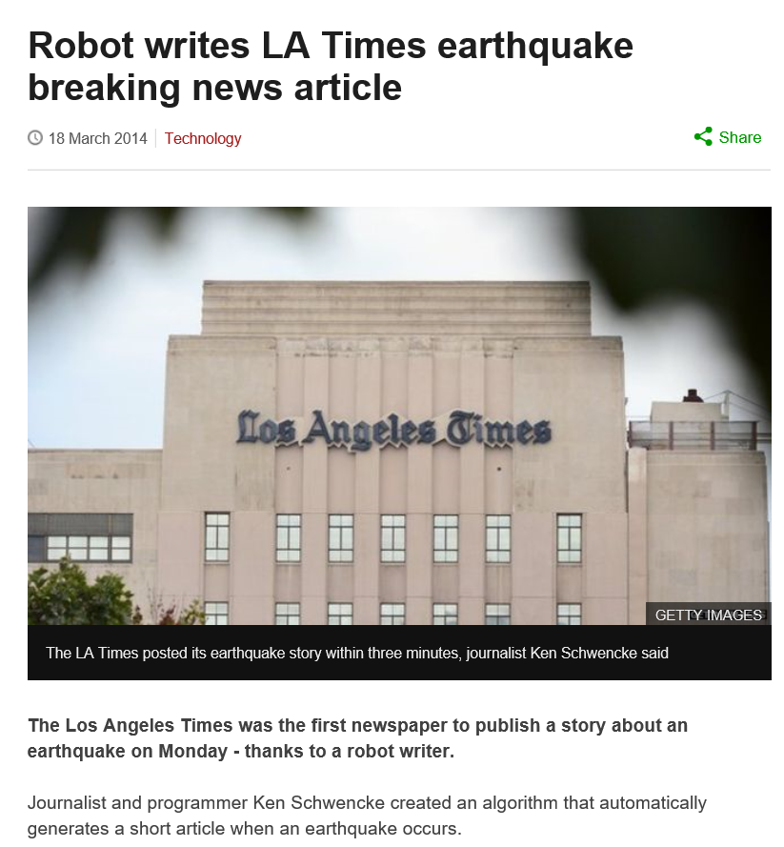
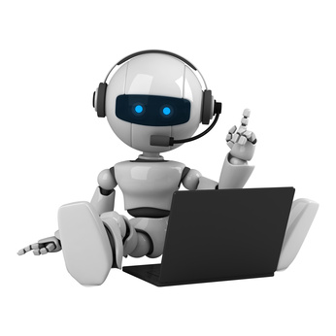
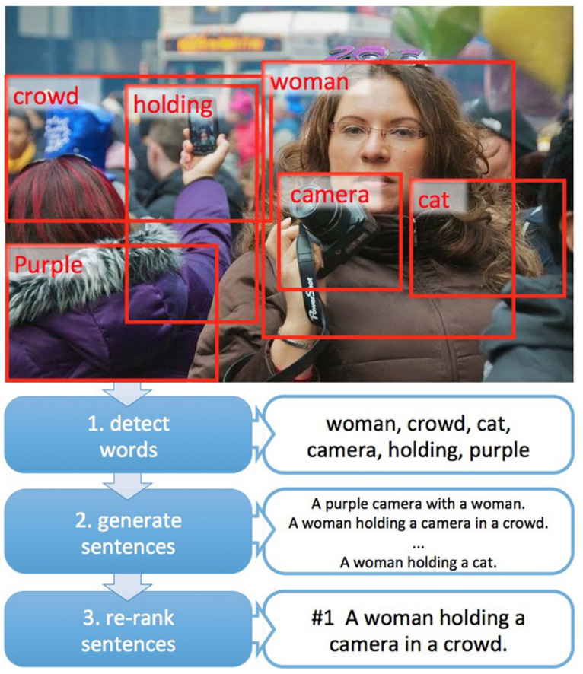
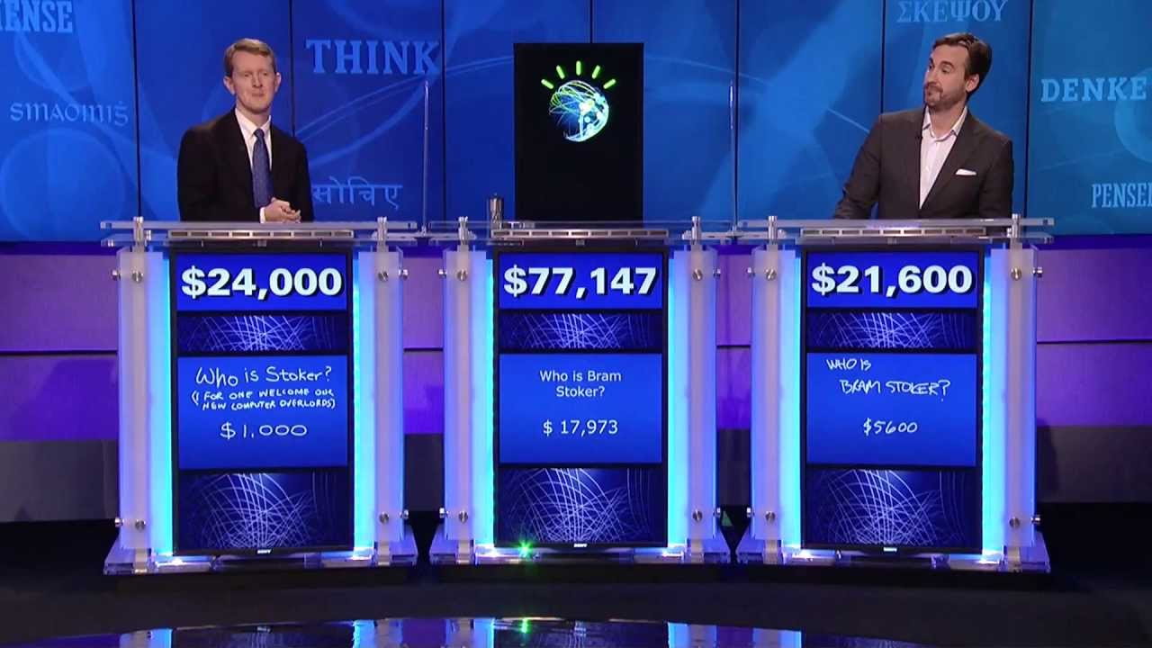
Notes:
Imagine you can have chat bots who understand your query, and gives you a coherent answer or can even counsel you when you are feeling down.
You can also have A computer that gives a quick report of an Earthquake that happened in the wee hours.
An Automatic Image captioning technology where a computer is capable of describing the surrounding to the blind.
With these wonderful use cases, What’s the catch. For those who raised your hands, you will know that deep learning can be computationally very expensive, especially when the structure of network is very deep.
Text analytics itself can be very expensive. In the next few slides, I will showcase some operations commonly performed in text analytics, and highlight where computation are expensive.
Src: https://medium.com/deep-writing/harry-potter-written-by-artificial-intelligence-8a9431803da6#.8mydijk4y

Slide 10
Demonstration

Slide 11
Lesson Summary
Notes:
We have taken a look at what text analytics is, and what are the applications. We have even seen a piece of text written using deep learning. The algorithm is able to derive some kind of structure from the text and output seemingly logical sentences.
Then we looked at some basic text analytics operations. We tokenized the sentences, remove punctuations and stop words, stem and lemmatize the token. After that, we counted the frequency of each word, and parsed it into a structured matrix. We converted the matrix into a sparse matrix to save memory.
Tokens can be enhanced by introducing part of speech, ngrams, entity recognition, and sentiment.
And all these are just for cleaning the text!
finally, to analyse the text, I introduced the cosine similarity and topic modelling.
So you see, the shortcomings of current state of the art is that it does not take into account the semantics of the words. You could well apply the same techniques to texts written by a monkey, and the techniques will still work. But the result will totally make no sense. I believe that the basis of text analytics should be learnt like how we learnt languages. Only when the computer has been taught some basics, can it learn to surf the web on its own, to learn more.
I shall stop being philosophical here, and hand over to… . Thank you for listening.

Slide 12
Summary
what text analytics is, and its applications.
Basic text analytics operations.
Tokenization, remove punctuations and stop words, stem and lemmatize the token.
Vector representation of text
Sparse matrix
Enhanced Tokens
POS
Ngrams
Entity recognition
Sentiment Analysis
Text analysis
cosine similarity
topic modelling.

Slide 13
Summary
shortcomings of the current state of art
does not take into account the semantics of the words.
Relationship of words.
Other topics not covered
Document classification.
Document summarization.
Notes:
You could well apply the same techniques to texts written by a monkey, and the techniques will still work. But the result will totally make no sense. I believe that the basis of text analytics should be learnt like how we learnt languages. Only when the computer has been taught some basics, can it learn to surf the web on its own, to learn more.

Slide 14
Source: Deutsch, M. https://medium.com/deep-writing/harry-potter-written-by-artificial-intelligence-8a9431803da6#.8mydijk4y
Notes:
Back to the abstract from the new Harry Porter book you saw at the beginning of this talk.
How many of you believe what I said that this is a draft of the new Harry Potter book?
- if someone raises their hand
Thank them for entertaining me, and not making me look bad.
Else:
“This is the smartest audience I have since. You are right,”
This piece of text is written by a computer using a deep learning algorithm called LSTM Recurrent Neural Network.
Although the story doesn’t seem to flow, the deep neural network seem to be have figured out some structures in the sentences.
- The punctuations are mostly in the right places,
- speech is properly enclosed with quotation marks, followed by or following a “said”, or “yell”.
- Nouns like “Harry”, “Sirius” are mostly in the right places.
I think this is quite remarkable what deep learning can do.
Can I have a show of hand who has heard of deep learning. And who knows what deep learning is?
Thank the audience for participating.
Each layer of a deep learning network is said to find some patterns in the data. With something as colourful as text, it is very hard for someone to code all the text rules. There can be spelling mistakes, grammatical error, new vocabulary invented. So it is with the hope that deep learning is able to find these rules.
Text analytics in deep learning can be attractive because (next slide)

Slide 16
Q&A

Slide 17
Additional Slides

Slide 18
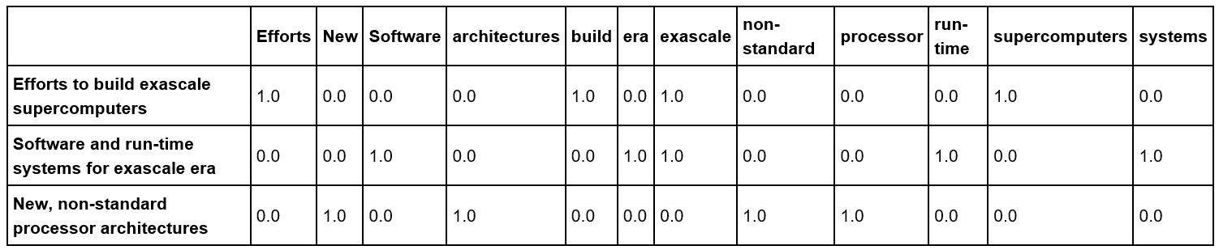
Structuring Unstructured Text
Texts are unstructured data, so need to be represented in a structured form, i.e. a matrix, before any analytics can be performed.
E.g. Vectorizing these sentences, result in a Document-Term matrix (DTM):
'Efforts to build exascale supercomputers‘
'Software and run-time systems for exascale era'
'New, non-standard processor architectures‘
Assigning value to words
Word count, Log(count of words), normalizing by length of text (e.g. count / total number of words in the sentence), tf-idf
Notes:
Vectorizing these 3 sentences results in a matrix of dimensions 3x12. where each row is the vector of the corresponding document.
This matrix is called a dense matrix.
Given the number of words that exist, the dimension of the matrix (termed the DTM) can be very big. Applying machine learning operations (some are mathematical operations, some are lookup operations) on this matrix becomes very computationally expensive.
There are others ways of assigning values to words

Slide 19
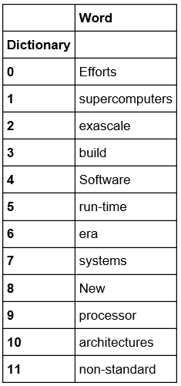
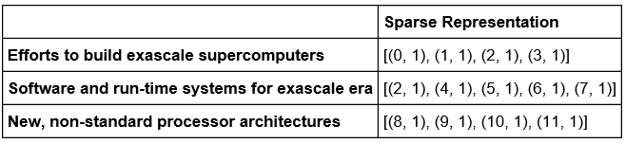
Structuring Unstructured Text
Dense Matrix
Sparse Matrix
Notes:
There is a problem with this method of representing text,
- there are many zeros in the dense matrix. It is expensive, storage wise, to store information about no information, i.e. the zeros.
The next few slides will show the common operations performed on the DTM.
A sparse matrix representation is typically done.
This is a space efficient way of structure text data. But it does have some implications on computation time.
I’ll you this by introducing another operation, called similarity calculations.

Slide 20
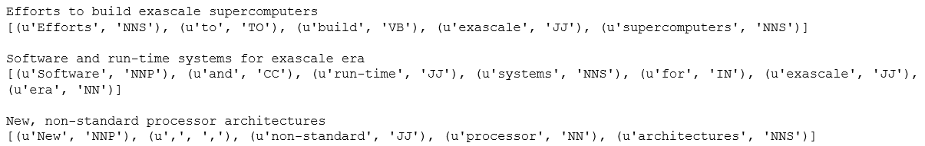
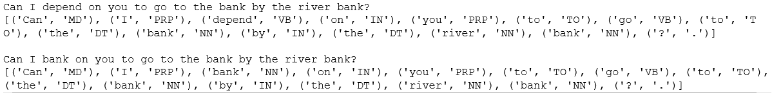
Part of Speech Tagging
E.g. POS: Nouns, Verb, Adjective, Determiner, Adverb, Pronoun, Preposition etc.
Developed via manual tagging → by Linguist, or subsequently, by a machine learning model, rule based
Off-the-shelf POS tagger
Penn Treebank.
NNP – Proper noun, NNS – Noun Plural, VB - Verb base form, JJ - Adjective, etc.
(Reference: http://www.clips.ua.ac.be/pages/mbsp-tags)
Notes:
Verb → action
Determiner → a, some, many
Adverb → describes a noun (merrily, quickly)
Pronoun → replaces a noun (I, he, she)
Prepostion → at, there, on, but
These words, with the part of speech tags, can be included in the vector matrix as the feature.
There are some words which can take multiple part of speech, therefore extending the number of columns in the table.

Slide 21
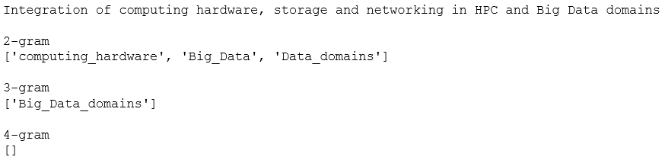
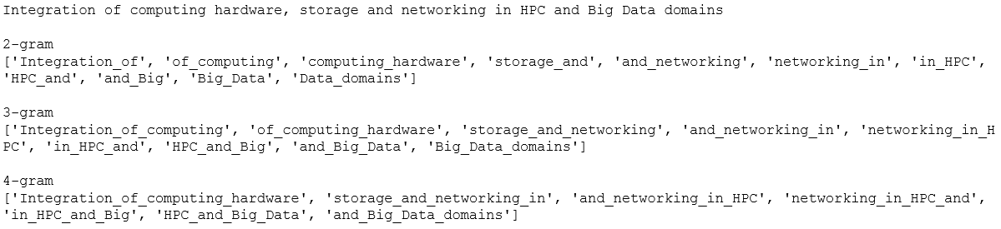
Ngram
Join pieces of words together
Bigram → joining 2 words
Trigram → joining 3 words
Quad-gram → joining 4 words
Notes:
Hidden text box contained in this slide

Slide 22
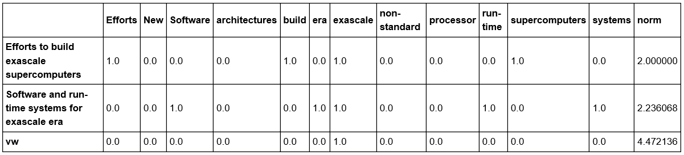
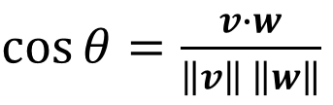
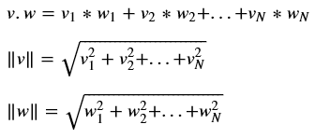
Similarity Between Documents
Cosine Similarity
v
w
v_{i} * w_{i}
Cosine Similarity = 1 / 4.472136 = 0.2236068
What does the similarity score say about these 2 documents?
Notes:
Sometimes, we want to find out how similar 2 pieces of text are. This can be calculated using the cosine similarity formula
If you have represented 2 documents a vectors.
Now we have a way to compare how 2 articles are similar. But similarity in this context is just a relative concept.
Therefore, similarity is more useful when it comes to comparing between more than 2 documents.

Slide 23
Topic Modeling
Tries to find topics from bag of words.
Each topic consists of group of words.
Algorithm
Latent Semantic Analysis (LSA)
Latent Dirichlet Allocation (LDA)
Each document has a probability distribution over a set of topics
Each topic has a probability distribution over the words in the vocabulary
Notes:
LSA → SVD
LDA → Probabilistic assignment of words to topic With Prior probability

Slide 24
Operations on Text (need to research more on this.)
I’m listing the operations here. Later on, each item may take 1 slide
Mathematical Operations
Lookup Operations (?)
Tokenization (not a mathematical nor lookup operations. Need to relabel)
Counting and tf-idf
Cosine Similiarity
O(n2) where n is the number of documents.
Co-occurance metrics
Spell check
Edit distance
Classification type operations
Matrix multiplication.
Matrix inversion (?)
Differentiation for machine learning tasks.
First order differentiation.
Second and higher order differentiation
Stop words removal
Part of Speech
should we include POS as one of the features in the matrix, the matrix will
Spell check
Stemming (? Lookup rules to stem?)
Lemmatization
Sentiment
Ngrams
In a language like Chinese, individual characters may not convey the right meaning. Only a combination of characters result in POS such as nouns or adjectives. Combination of Chinese character implies a deeper and/or more profound meaning. So we need to know the number of characters to combine to retrieve the meaning of the text.
Abbreviations

Slide 25
Examples of HPC + ML
The high-performance computing (HPC) market has been traditionally quite different from the emergent machine learning/AI market.
However, the rise of AI-optimized chips is starting to blend the two markets together, as supercomputers start adopting the same kind of chips. As the AI chip market evolves, the chips become more efficient, higher-performance, and more cost-effective.
Making them interesting to the supercomputer customers.
Date | Examples | Source
17 Feb 2017 | The Tokyo Institute of Technology announced plans to launch Japan's "fastest AI supercomputer“ (Tsubame3.0) which uses Nvidia’s GPU accelerators to double its performance over the Tsubame2.5 predecessor. | http://www.tomshardware.com/news/nvidia-japan-fastest-ai-supercomputer,33683.html
21 Feb 2017 | Baidu’s Silicon Valley AI Lab (SVAIL) announced an implementation of the ring allreduce algorithm for the deep learning community, which will enable significantly faster training of neural networks across GPU models. | http://www.tomshardware.com/news/baidu-svail-ring-allreduce-library,33691.html
Notes:
With the ring allreduce algorithm, less time is spent sending data and more is spent doing computations on that data locally on each GPU.
- This algorithm in from the HPC world.

Slide 26
Reference
http://healthitanalytics.com/features/what-is-the-role-of-natural-language-processing-in-healthcare
Reference for the slide “Use Case in HealthCare
http://www.tcs.com/SiteCollectionDocuments/White%20Papers/Insurance_Whitepaper_Mining_Unstructured_Text_Data_for_Insurance_Analytics_08_2010.pdf
Reference for text analytics in the insurances industry.
http://www.scientificcomputing.com/blog/2014/01/text-mining-next-data-frontier
http://searchbusinessanalytics.techtarget.com/feature/Text-analysis-software-helps-Lenovo-zero-in-on-the-customer
http://karpathy.github.io/2015/05/21/rnn-effectiveness/
https://medium.com/deep-writing/harry-potter-written-by-artificial-intelligence-8a9431803da6#.8mydijk4y

